Slide 1
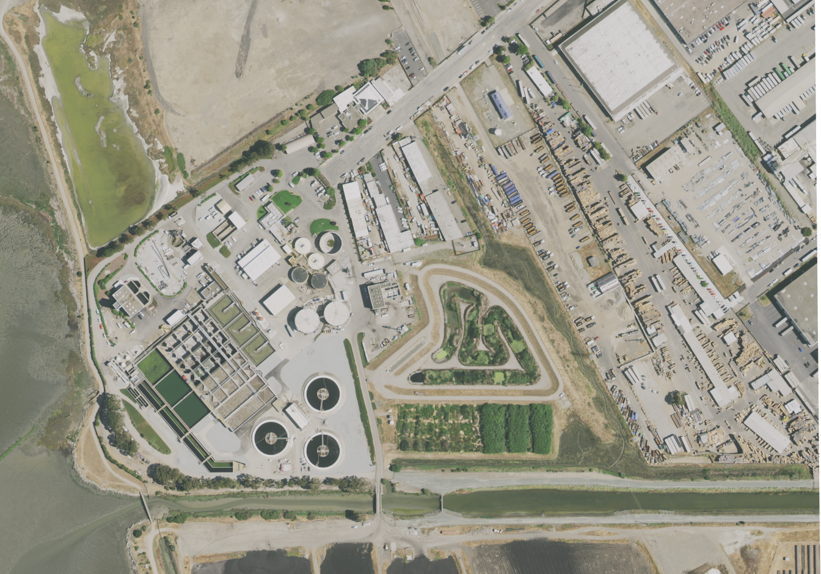
WWTP Project Update
March 20, 2024

Slide 2
Outline
Overview of previous model and aggregated results
Status update of model tuning and inference
Upcoming Activities

Slide 3
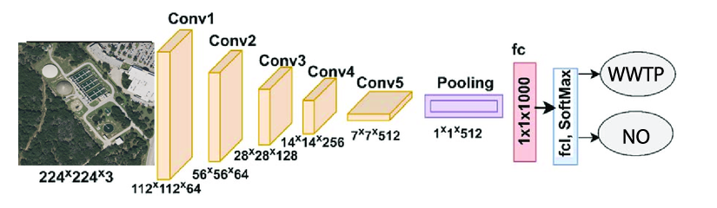
Previous Model
Pre-trained ResNet-18 from Deep Residual Learning for Image Recognition on ImageNet
Residual Network-18: a convolutional neural network that is 18 layers deep

Slide 4
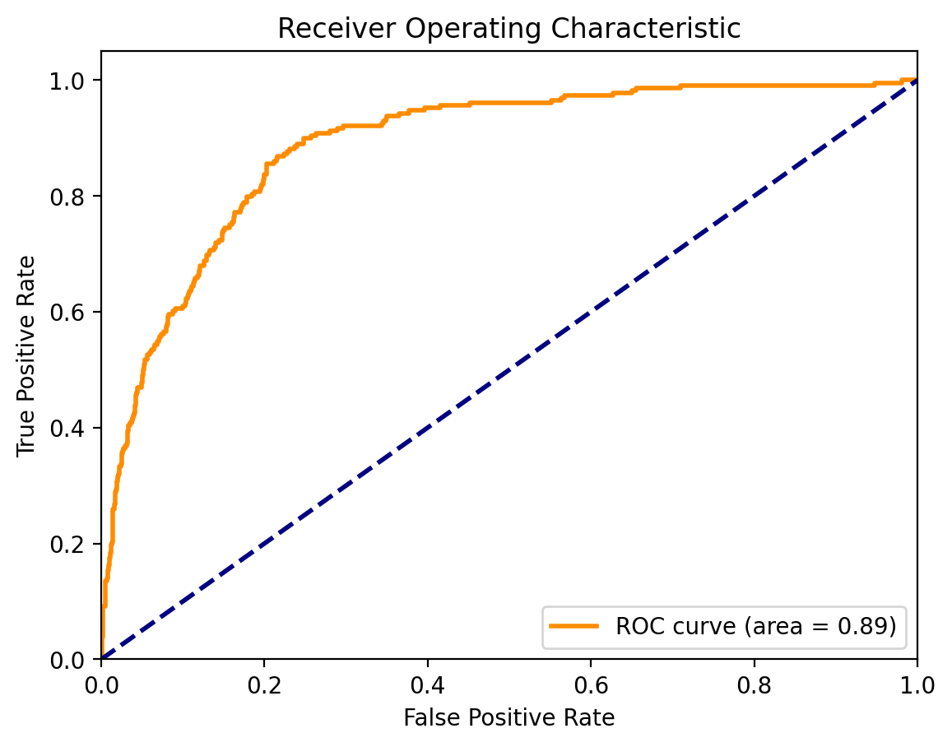
Previous Model
Precision: 0.6320
Recall: 0.8227
F1 Score: 0.6497
Accuracy: 79.59%
Comparing to Training
Precision: 0.7951
Recall: 0.7679
F1 Score: 0.7747
Accuracy 79.02%

Slide 5
Aggregated California and Texas Results (OSM + HydroWaste)
WWTPs: 905 (out of 5,247)
Solar WWTPs: 63
Excel Sheet: Aggregated CA and TX WWTP Verification from OSM and HydroWaste_031824

Slide 6
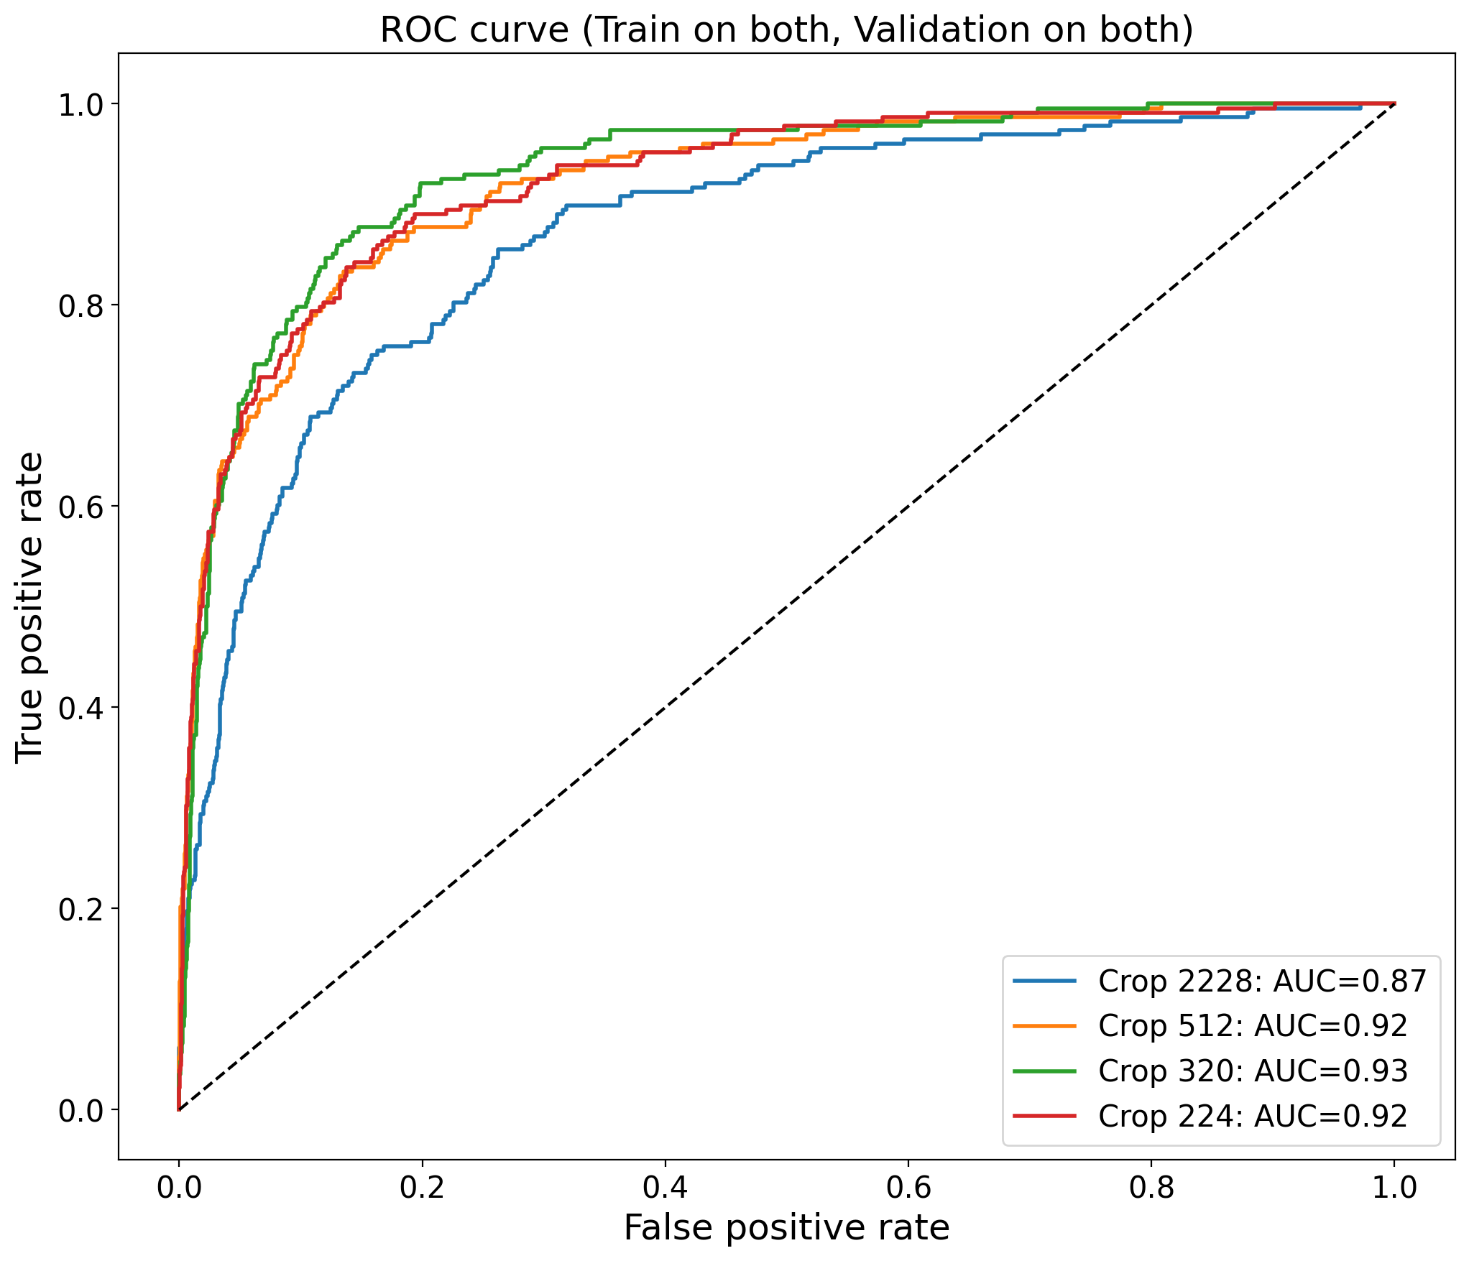
Model Experimental Design
Pre-trained ResNet50
Center Crop Size | Pretrained ImageNet Weights
 | AUC | max F1 score
Original (2228 * 2228) | 0.87 | 0.5198
512 * 512 | 0.92 | 0.5075
320 * 320 | 0.93 | 0.6554
224 * 224 | 0.92 | 0.5635

Slide 7
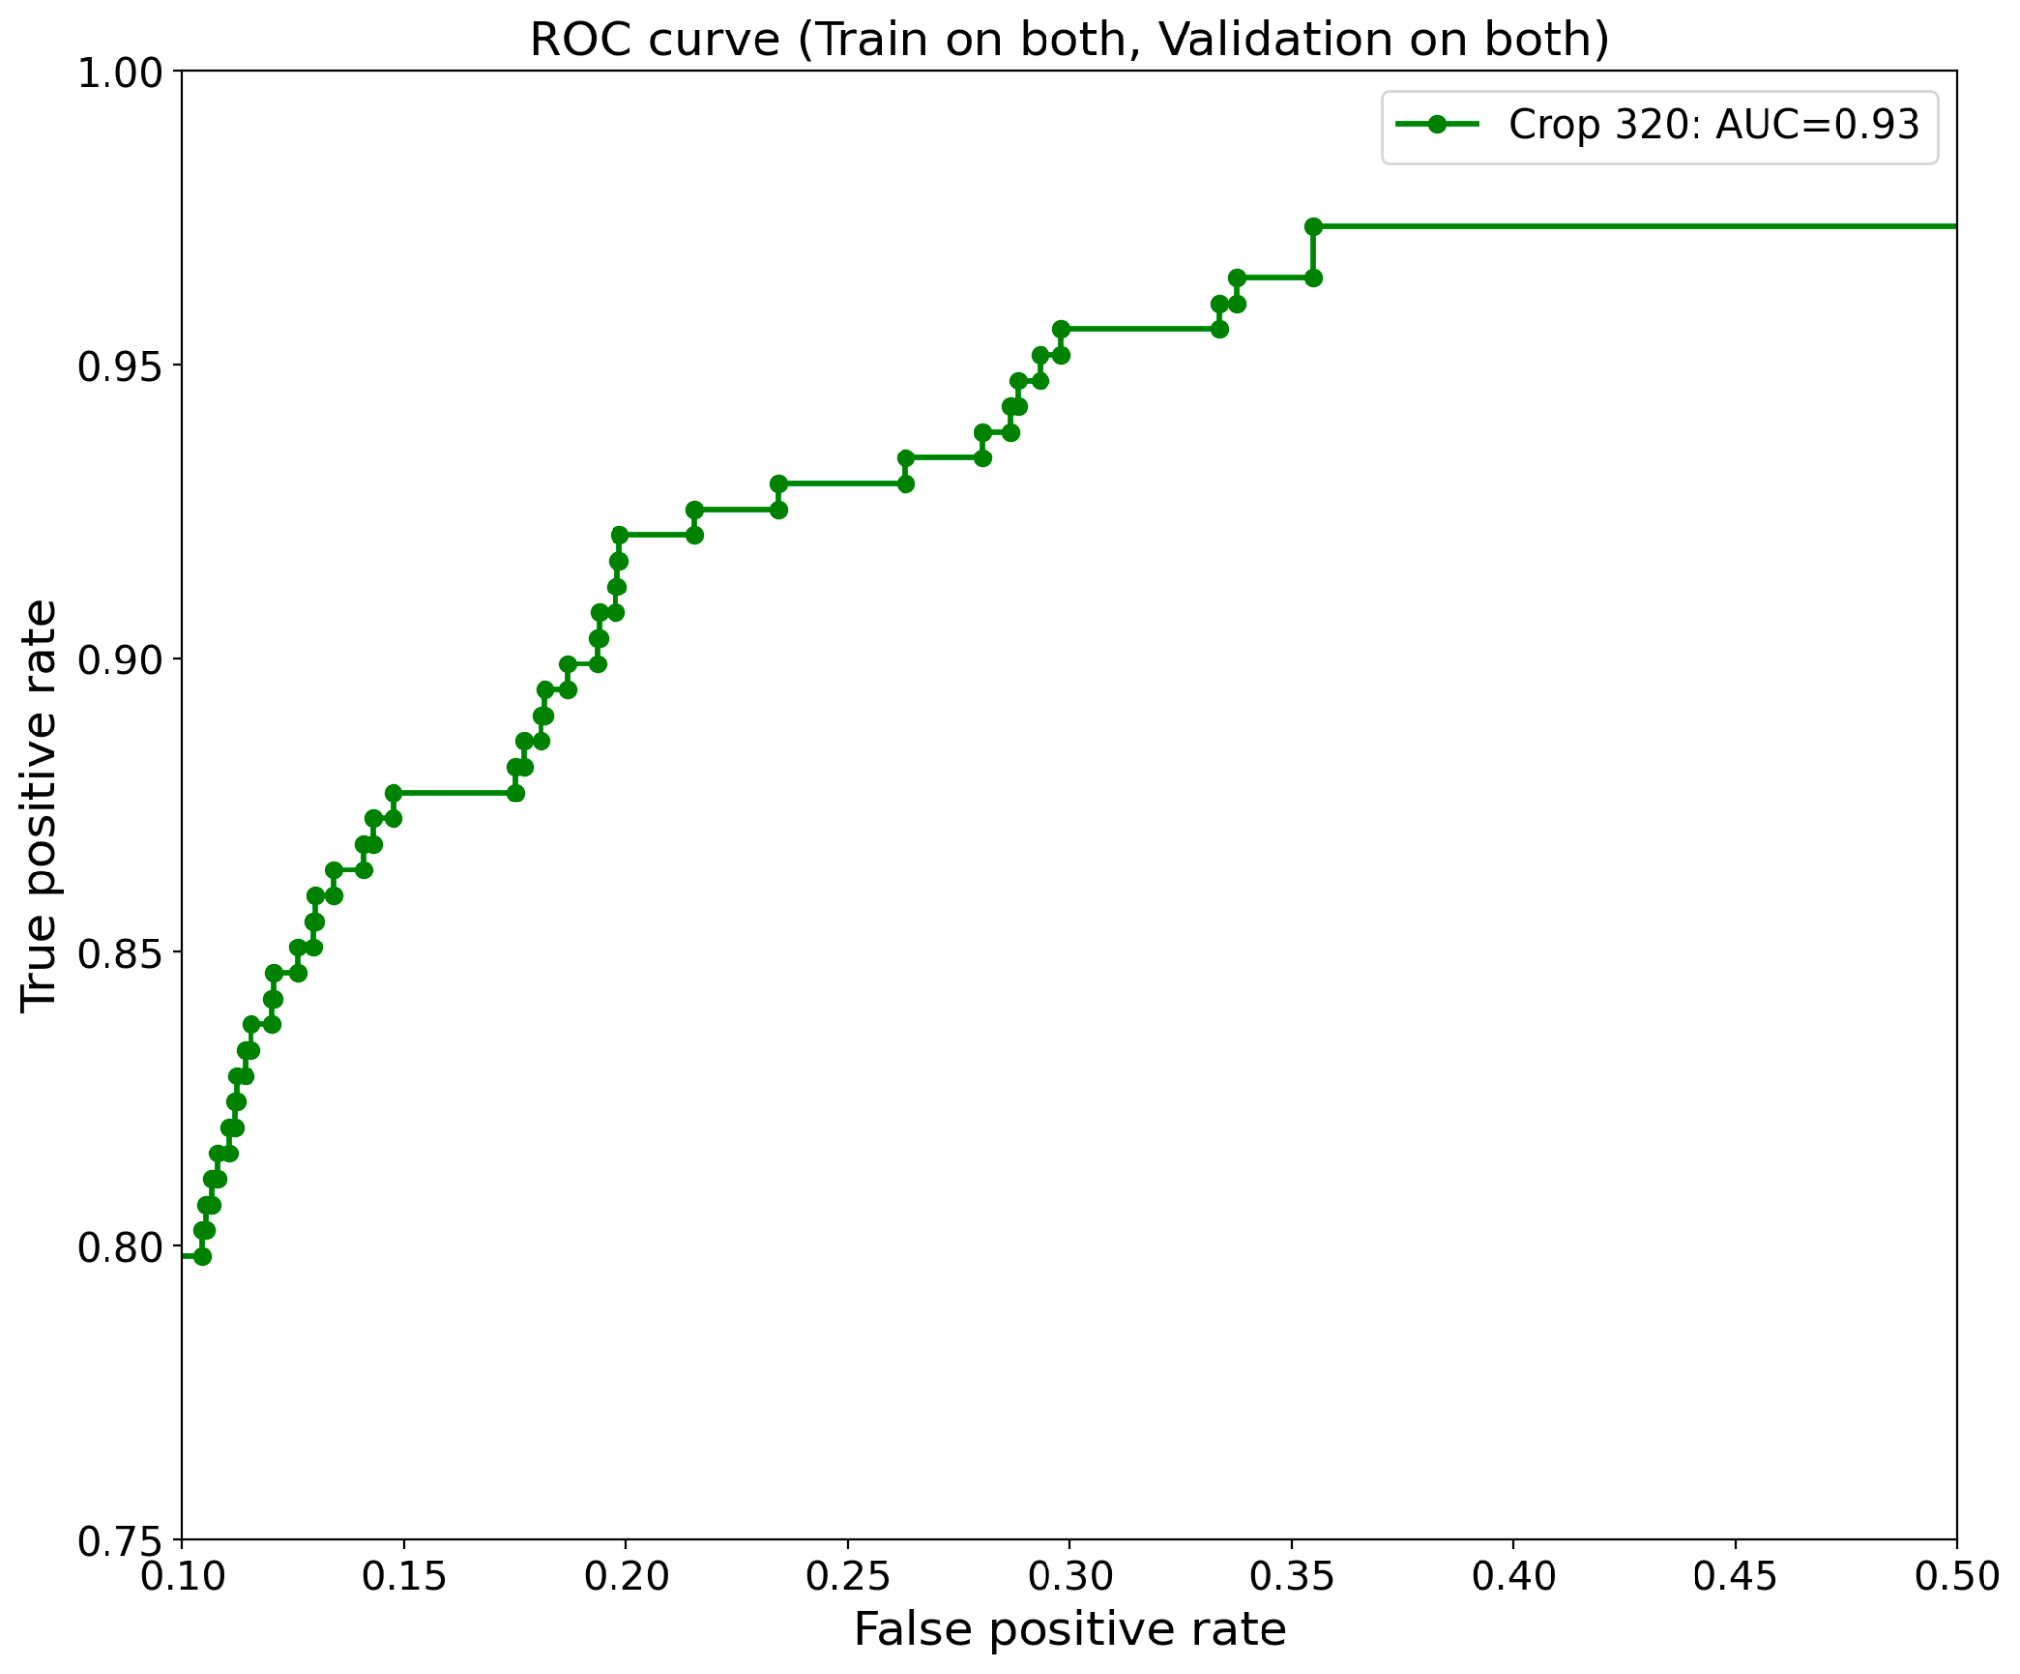
Zoom-in for crop size 320

Slide 8
Model Experimental Design
Experiment on all parameters/setting (see slide 6)
PICK BEST MODEL BASED ON ROC from experiments
Pretrained ImageNet Weights, Crop size: 320 * 320
Utilize Best Model Within Domain vs Cross Domain
Within Domain: Train on Texas, Validate on Texas; Train on California, Validate on California
Cross Domain: Train on Texas, Validate on California; Train on California, Validate on Texas
 |  | Validation On
 |  | Texas (YZ) | California(DK) | Texas + California
Training On | Texas | AUC:0.93, Max F1: 0.8454 | AUC:0.89, Max F1: 0.5482 | NA
 | California | AUC:0.75, Max F1: 0.6175 | AUC:0.91, Max F1: 0.6139 | NA
 | Texas + California | AUC:0.94, Max F1: 0.8229 | AUC:0.87, Max F1: 0.7277 | AUC:0.93, Max F1: 0.6554

Slide 9
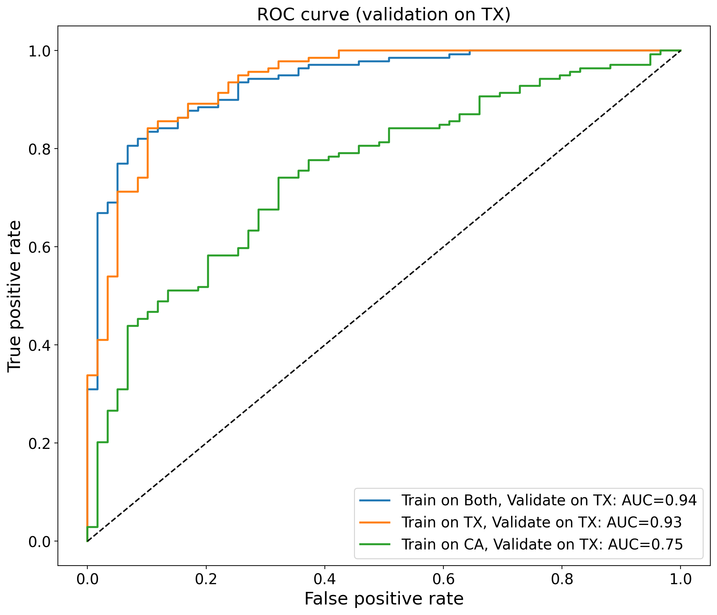
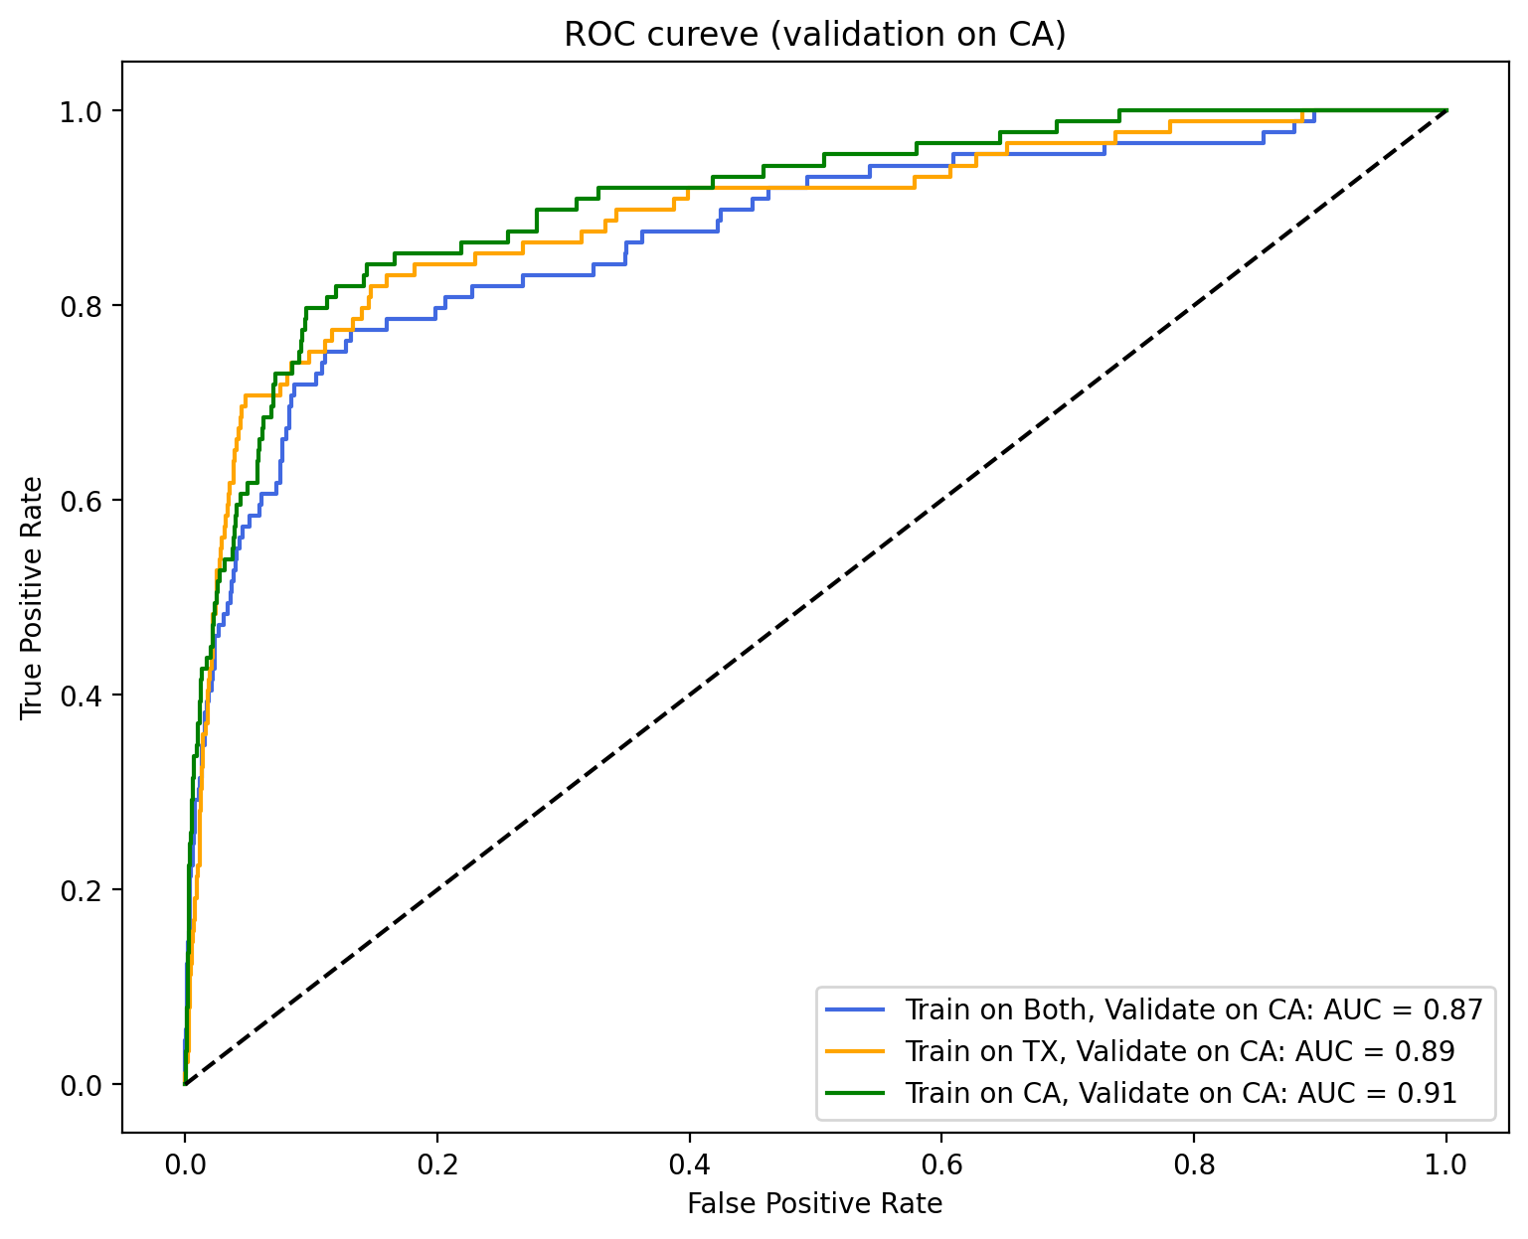
Model Experimental Design

Slide 10
Insights from the experiment
Training with images in the same state as the validation images (Within Domain) yields better performance than training in a different state from the validation images (Cross Domain)
Nevertheless, cross-domain training still presents descent F1 scores and auc metrics, which demonstrates our model’s generalization and predictive ability across disparate WWTP sites.
The result shows that transform learning has great potential, and we are confident while applying the best fine-tuned model to nationwide candidate dataset

Slide 11
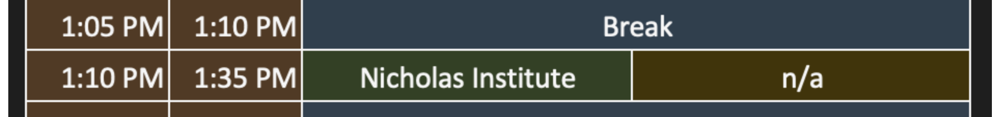
Upcoming Activities
Reminder: Capstone Symposium next Friday (3/29) - Scheduled Presentation 1:10 PM - 1:35 PM EST
Email with Christine, Kyle, Greg, and Andrea
Final Report providing overview of Data Collection, Data Analysis/Exploration, Modeling, and Results
List of WWTP Candidates and verified list based on the model inference
GitHub repository of codebase for replication and further analysis, including fine-tuned weights and Jupyter Notebooks of model implementation
Google Drive of Downloaded WWTP Images and all the slide decks we have

Slide 12
Next Week’s Plan
Experiment
Texas | CA | CA + Tex
Validation | Validation | Validation
Training Set | Training Set | Training Set
Train: TX
Val: TX
Train: TX
Val: CA
Train: TX + CA
Val: TX + CA
Within domain
Cross domain

Slide 13
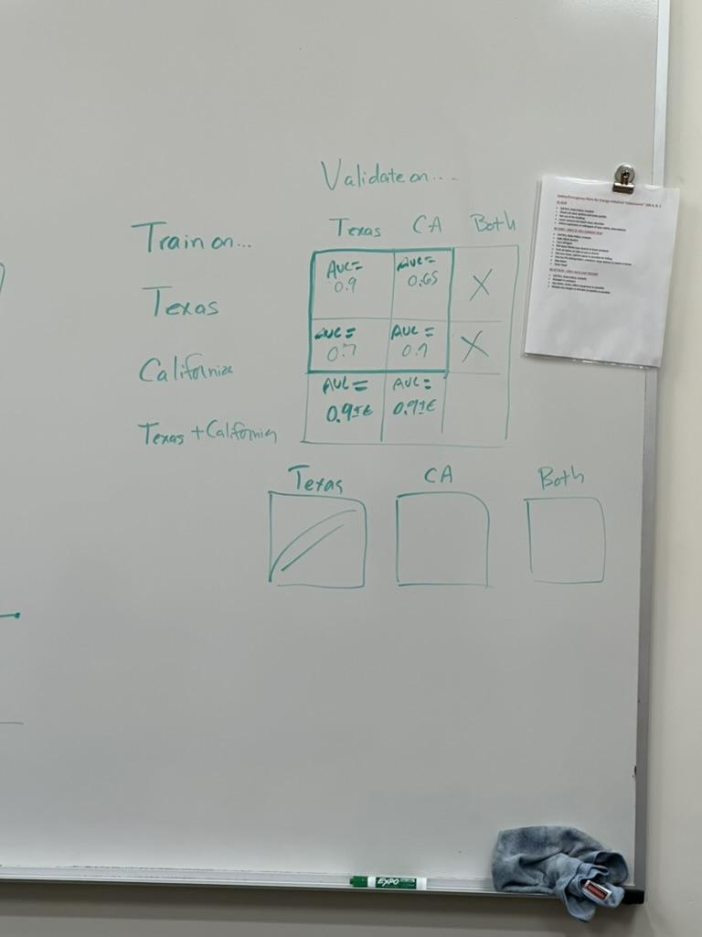
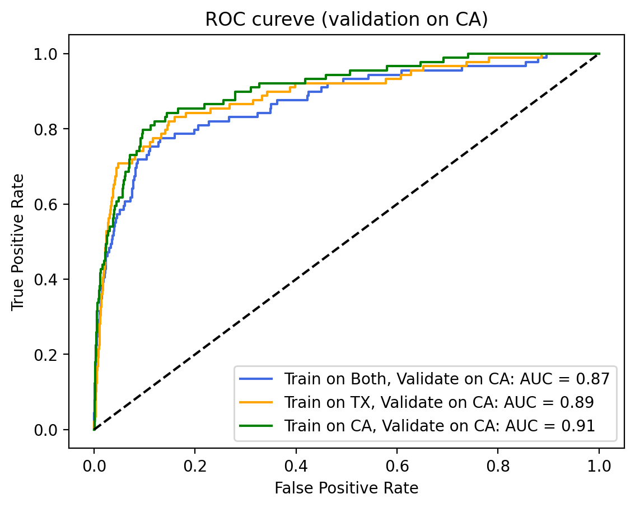
Model Experimental Design
Roc curves for each column

Slide 14
